Slide 1
Practical data science with pandas and python
Gunesh Shanbhag

Slide 2
Agenda
Introduction
Reading data using Pandas
Pandas data-frame deep dive
Exploratory Data Analysis
Data Visualization
Dealing with missing data

Slide 3
What is Data Science?
Data Science is the science of analyzing raw data using statistics and machine learning techniques with the purpose of drawing insights from the data.
It is used in many industries to allow them to make better business decisions and in the sciences to test models and theories.

Slide 4
Practical Data science perspective
Read Data
Data Processing and cleaning
Summarizing Data
Deriving insights from data
Visualization

Slide 5
Introduction to Pandas

Slide 6
Introduction to Pandas
Pandas provides a high performance, easy to use data structures and analysis tools for the python programming language.
Its an Open Source python library which provides high performance data manipulation and analysis tool
Name Pandas is derived from the word “Panel Data” – an econometrics term for Multi-dimensional data

Slide 7
Pandas
Pandas deals with dataframes
Name | Dimensions | Description
Dataframe | 2 | 2 Dimensional size mutable Potentially heterogenous tabular data structure with labelled axes (rows and columns)

Slide 8
Creating copy of original data
In python, there are 2 ways to create copies
Shallow Copy And Deep Copy
Name | Shallow Copy | Deep Copy
Function | samp=df.copy(deep=False) samp=df | df1=df.copy(deep=True)
Description | It only creates a new variable that shares the reference of the original object Any changes made to a copy of object will be reflected in the original object as well | In case of deep copy, a copy of object is copied in other object with no reference to the original. Any changes made to a copy of object will not be reflected in the original object

Slide 9
Reading data using Pandas

Slide 10
Reading data using Pandas
In this session
File Formats
Commonly used File Formats
Read data from
.csv format
.xlsx format
.txt format

Slide 11
File Formats
Standard way in which data is collected and stored
Most common format is spreadsheet format in which data is stored in rows and columns
Each row is called a record
Each column in a spreadsheet holds data belonging to same data type
Most common spreadsheet formats are Comma Separated Values and Excel sheets
Other formats include plain text, JSON, HTML, MP3, MP4 etc.

Slide 12
Comma Separated Values
Spreadsheet format
Format “.csv”
Each record is separated by a comma
Files where records are separated using a tab are called as Tab Separated Values
.csv files can be opened with notepad or MS-Excel

Slide 13
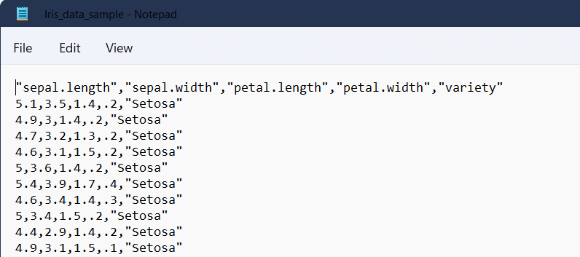
Comma Separated Values

Slide 14
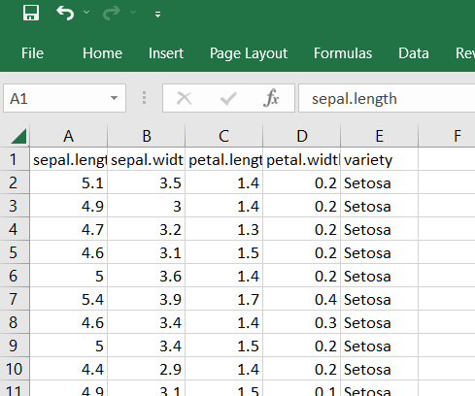
Comma Separated Values

Slide 15
Excel Spreadsheets
Spreadsheet format
Part of Microsoft office
Format “.xlsx”

Slide 16
Excel Spreadsheets

Slide 17
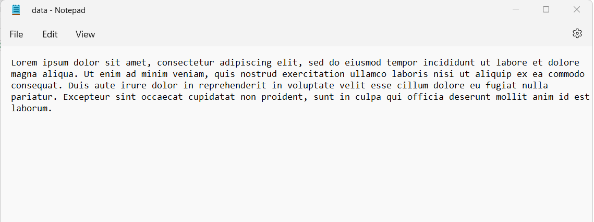
Text Format
Consists of Plain Text or Records
Format “.txt”

Slide 18
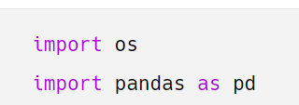

Importing Data
Importing necessary libraries
‘os’ library to changes the working directory
‘pandas’ library to work with dataframes
Change the working directory

Slide 19
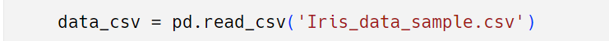
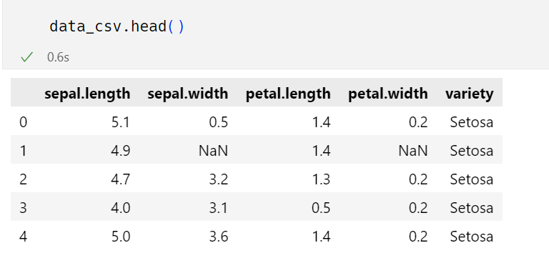
Comma Separated Values
Importing data
Blank cells read as ‘nan’

Slide 20
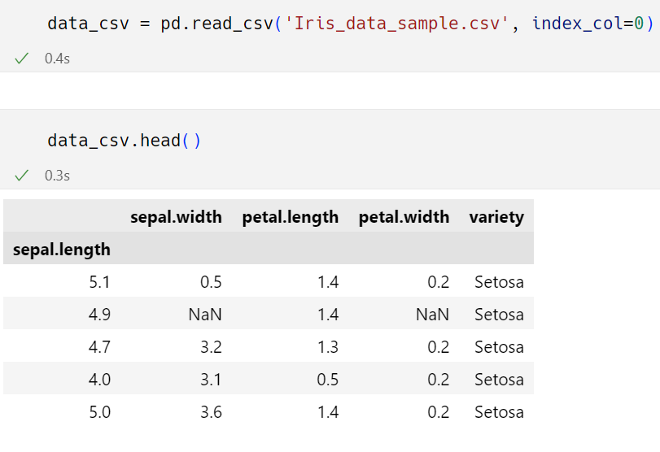
Comma Separated Values
Removing extra id column by passing ‘index_col=0’

Slide 21
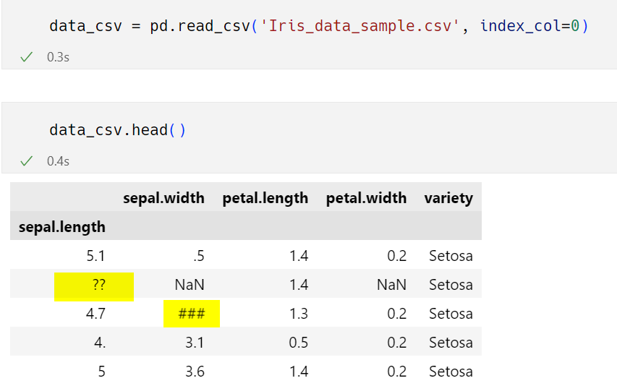
Comma Separated Values
Replacing ‘??’ and ‘###’ as missing values

Slide 22
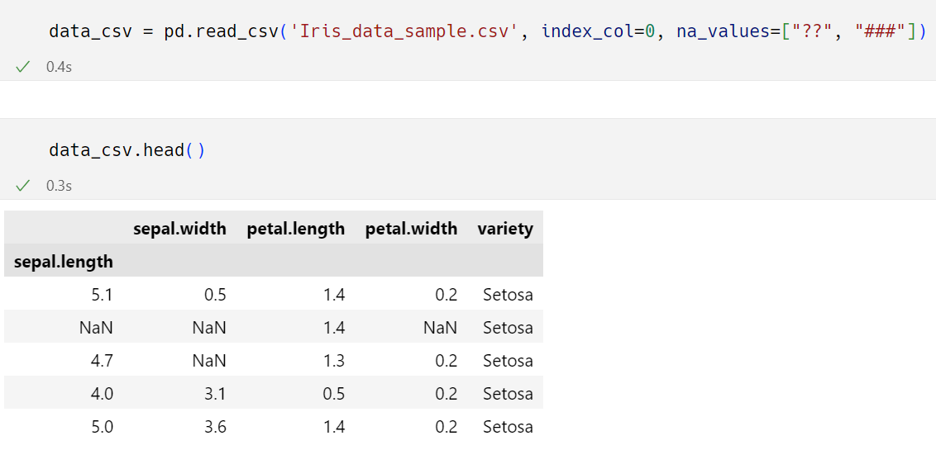
Comma Separated Values
Junk values can be converted to missing values by passing them as a list to the parameter “na_values”

Slide 23
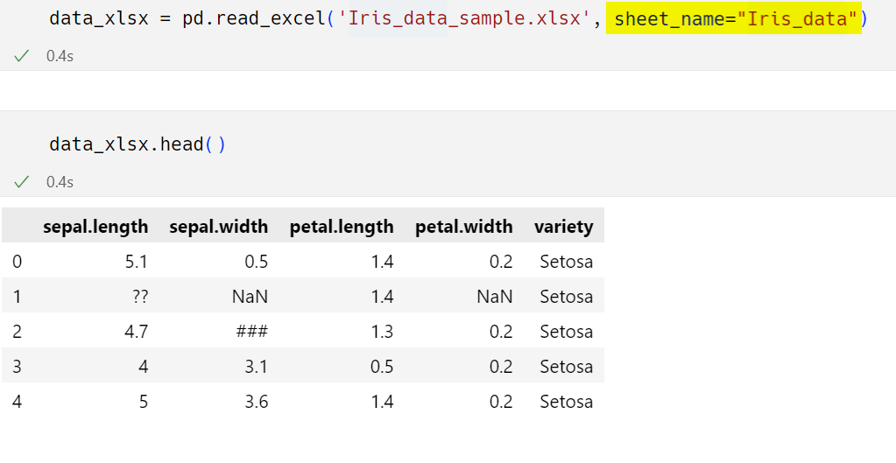
Excel Spreadsheets
Importing data

Slide 24
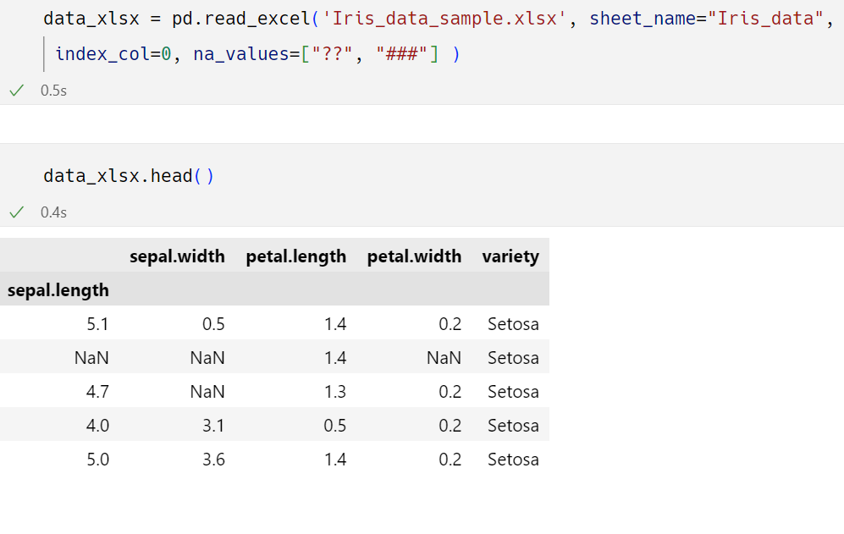
Excel Spreadsheets
Remove index column and replace ‘??’ and ‘###’ as missing values

Slide 25
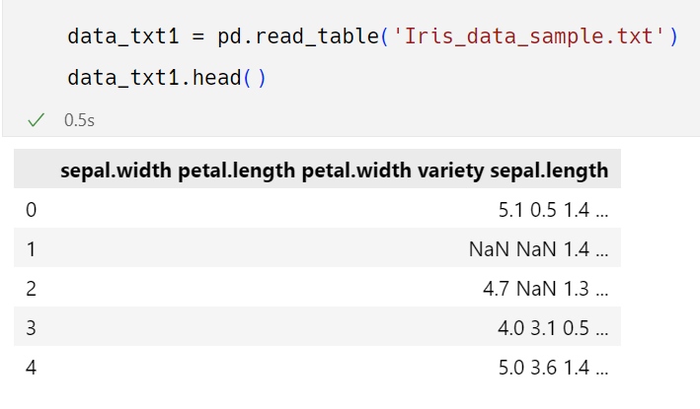
Text Format
Importing Data

Slide 26
Text Format
All columns are read and stored in a single column in dataframe
In order to avoid this, provide a delimiter to the parameters “sep” or “delimiter”

Slide 27
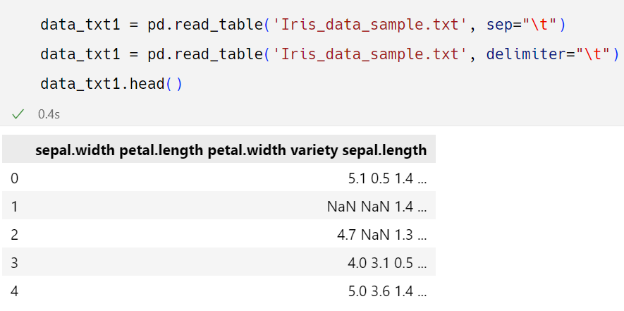
Text Format
Default delimiter is a tab represented by “\t”
Also tab delimiter might not always work

Slide 28
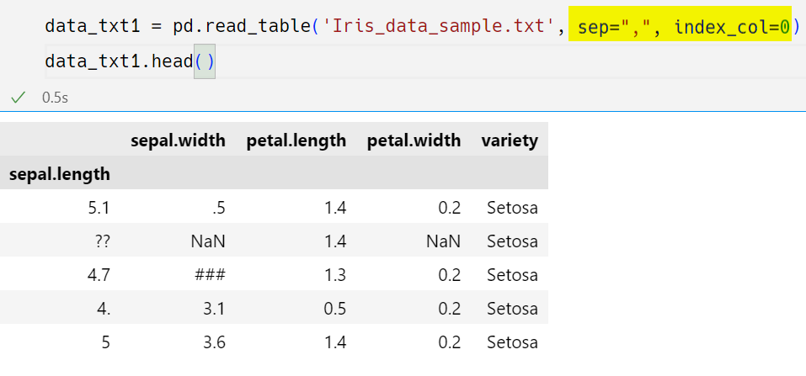
Text Format
Other commonly used delimiters are commas and blanks
In this case, using a comma as a delimiter also gives desired output

Slide 29
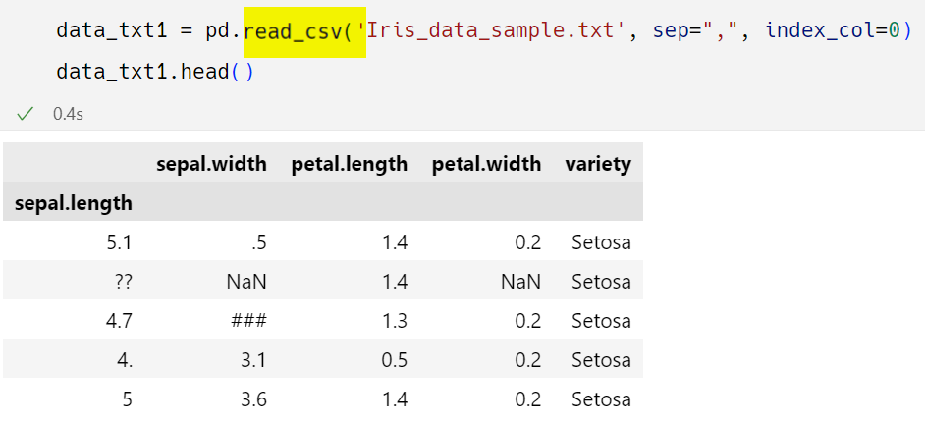
Text Format
Remove index column as replace “??” and “###” as missing values
Instead of using “read_table()” , “read_csv()” can also be used

Slide 30
Pandas Deepdive

Slide 31
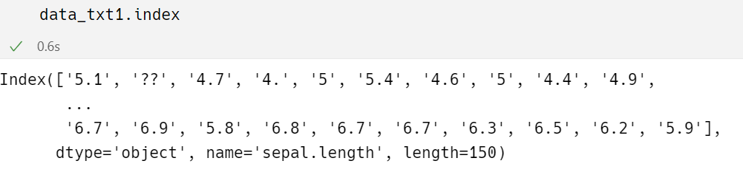
Attributes of Data
Dataframe.index
To get the index (row labels) of the dataframe

Slide 32
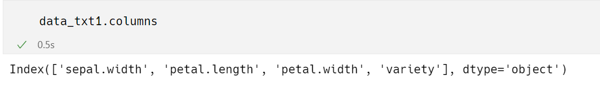
Attributes of Data
Dataframe.columns
To get the column labels of the dataframe

Slide 33
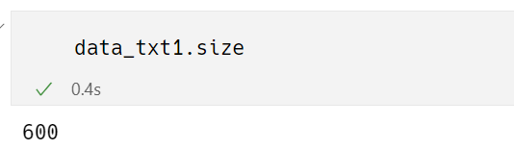
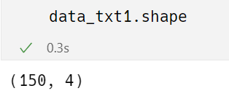
Attributes of Data
Dataframe.size
To get the total no of elements from the dataframe
Dataframe.shape
To get the dimensionality of the dataframe

Slide 34
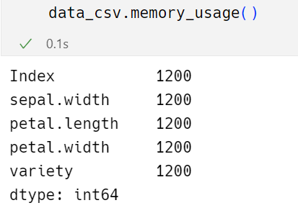
Attributes of Data
Dataframe.memory_usage
The memory usage of each column in bytes

Slide 35
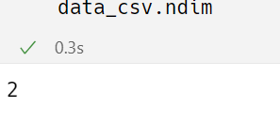
Attributes of Data
Dataframe.ndim
The number of axes / array dimensions
\
The 2 dimensional array stores data in a format consisting of rows and columns

Slide 36
Indexing and selecting data
Python slicing operator “[ ]” and attribute/dot operator “ . ” are used for indexing
Provides quick and easy access to pandas data structures

Slide 37
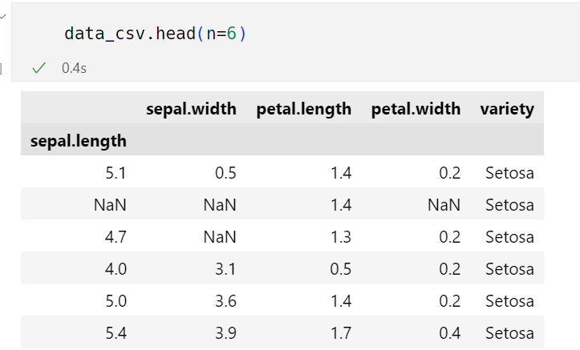
Indexing and selecting data
Dataframe.head([n])
The function head returns the first n rows from the dataframe

Slide 38
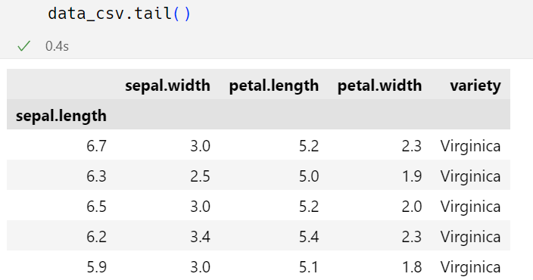
Indexing and selecting data
Dataframe.tail([n])
The function tail returns the last n rows from the dataframe
It is useful for quickly verifying data after sort or appending

Slide 39
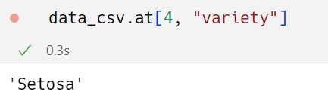
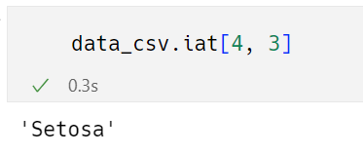
Indexing and selecting data
To access a scalar value, the fastest way is to use the “at” and “iat” methods
“at” provides label based scalar lookups
“iat” provides integer based lookups

Slide 40
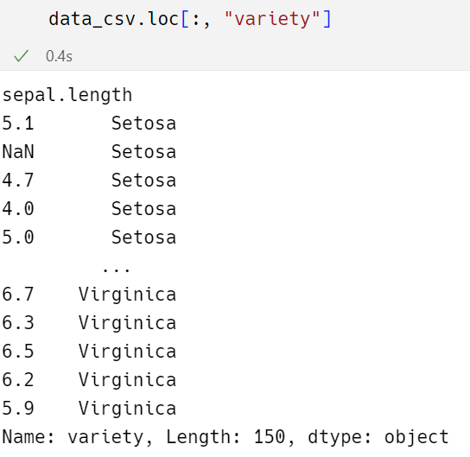
Indexing and selecting data
To access a group of rows and columns by label(s) “.loc[]” can be used

Slide 41
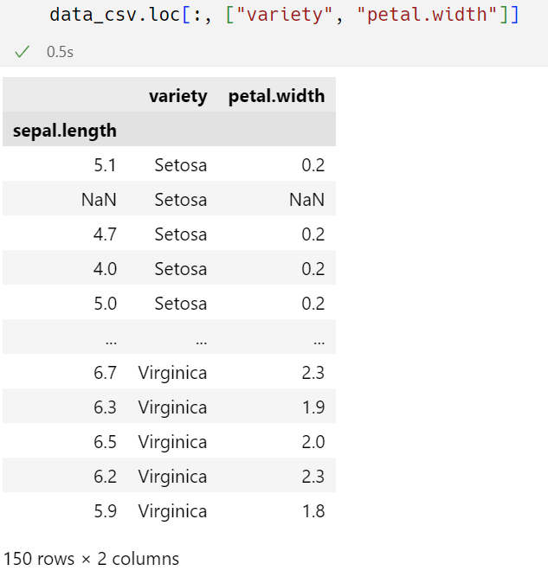
Indexing and selecting data
You can provide a group of columns too as a list

Slide 42
Pandas Datatypes

Slide 43
Datatypes
The way information gets stored in a dataframe or in any python object basically affects, whatever analysis that you are going to perform on your dataframe.
There are 2 main types of data
Numeric and Character data types
Numeric contain Integers and Floats
Eg. Integer 10 and Float 10.5
Strings are known as objects in pandas which can store values that contain nos and characters.
Eg. “category2”

Slide 44
Numeric types
Pandas and base python use different names for data type
64 simply refers to the memory allocated to store the data in each cell, which effectively relates to how many digits it can store in each cell
64 bits which is equivalent to 8 bytes
Python data type | Pandas data type
int | int64
float | float64

Slide 45
Character types
Differences between category and object
Category | Object
A string variable consisting of only a few different values. | The column will be assigned as object data type when it has mixed types (numbers and strings).
Converting such a string variable to categorical variable will save some memory | If a column contains “nan” then pandas will default to object datatype
A categorical variable takes on a limited, fixed number of possible values | For strings, the length is not fixed

Slide 46
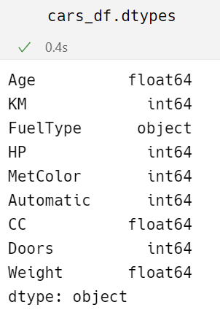
Checking data types of each column
“dtypes” returns a series with the data type of each column
Syntax: DataFrame.dtypes

Slide 47
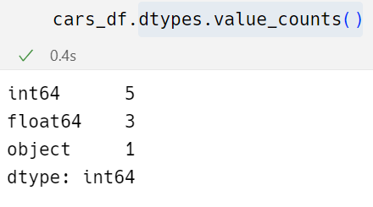
Count of unique data types
“dtypes.value_counts()” returns Count of unique data types in df
Syntax: DataFrame.dtypes.value_counts()

Slide 48
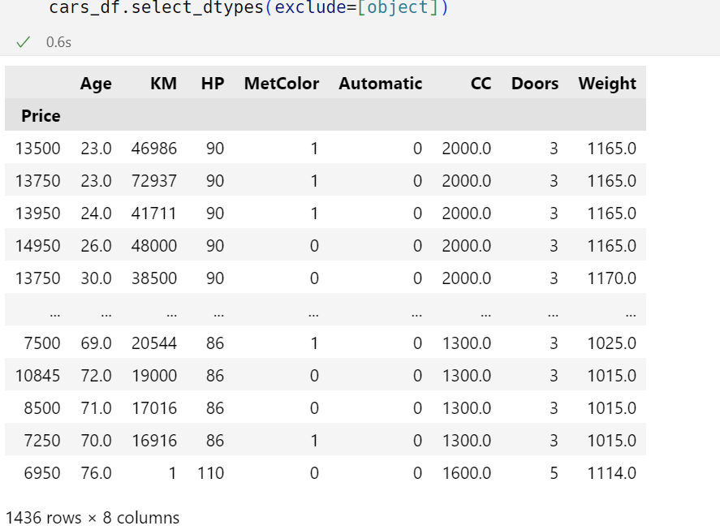
Select data based on data types
“select_dtypes()” select the data based on the data types from df.
Syntax: DataFrame.select_dtypes(include=None, exclude=None)

Slide 49
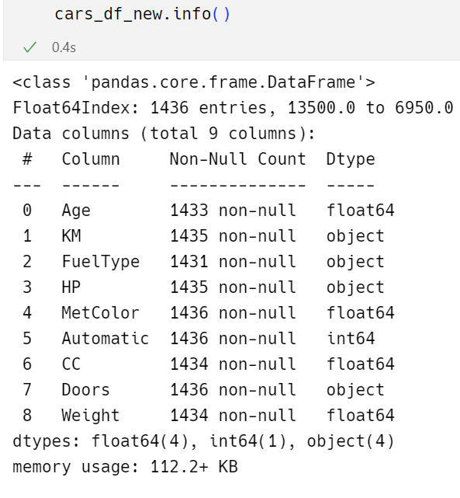
Concise summary of Dataframe
“info()” returns concise summary of df.

Slide 50
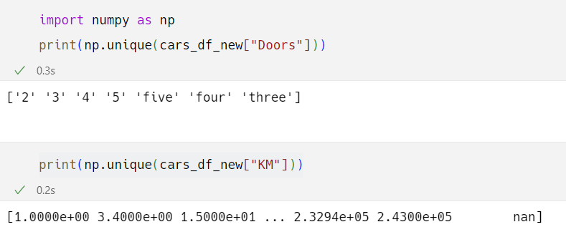
Unique elements of Columns
“unique()” is used to find unique elements of a column.
Syntax: numpy.unique(array)

Slide 51
Data Cleaning

Slide 52
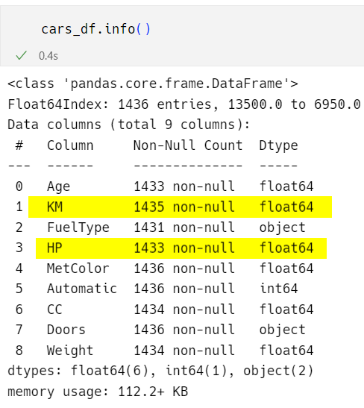
Convert unwanted values with nan
Before After

Slide 53

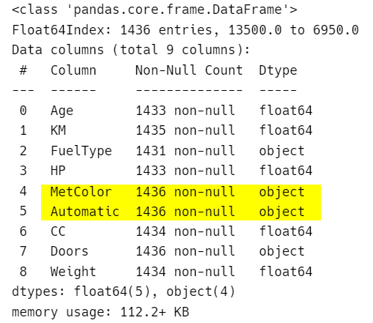
Converting variable’s data types
“astype()” method is used to explicitly convert data types
Before After

Slide 54
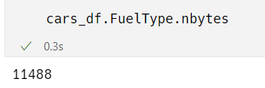
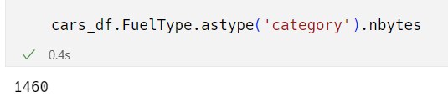
Category vs object data types
“nbytes()” method is used to get total bytes used by elements of cols
Syntax: ndarray.nbytes
If “FuelType” is of object data type
If “FuelType” is of category data type

Slide 55
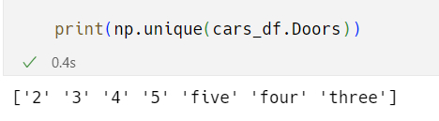
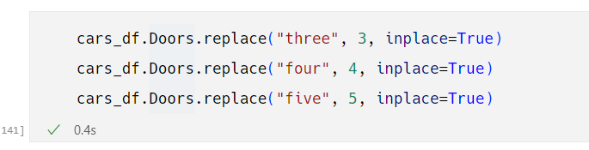
Cleaning Column Doors
“replace()” is used to replace a value with desired value

Slide 56
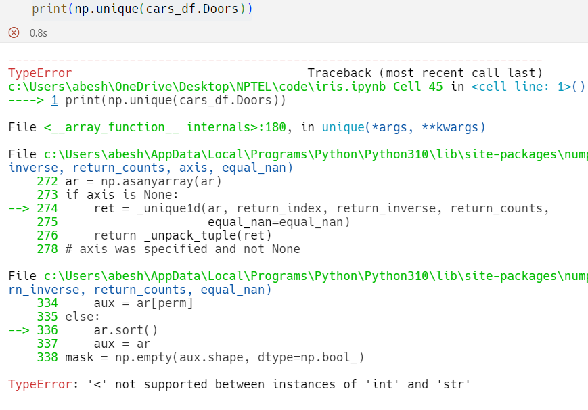
Cleaning Column Doors
If you check unique values now for column Doors, it will give you an error

Slide 57
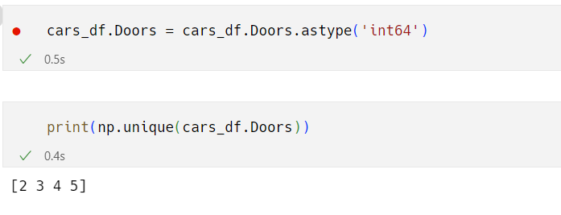
Cleaning Column Doors
Convert Doors to int64

Slide 58
Identifying missing values
In pandas, missing data is represented by NaN (abbrv. Not a Number)
To check null values in df, isnull() and isna() methods are used
Thesse functions returns a dataframe of Boolean values which are True for NaN values

Slide 59
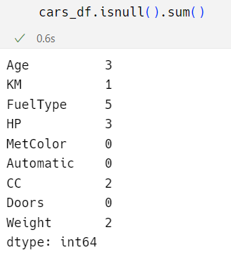
To detect missing values
Check count of missing values present in each column using
“DataFrame.isnull().sum()”

Slide 60
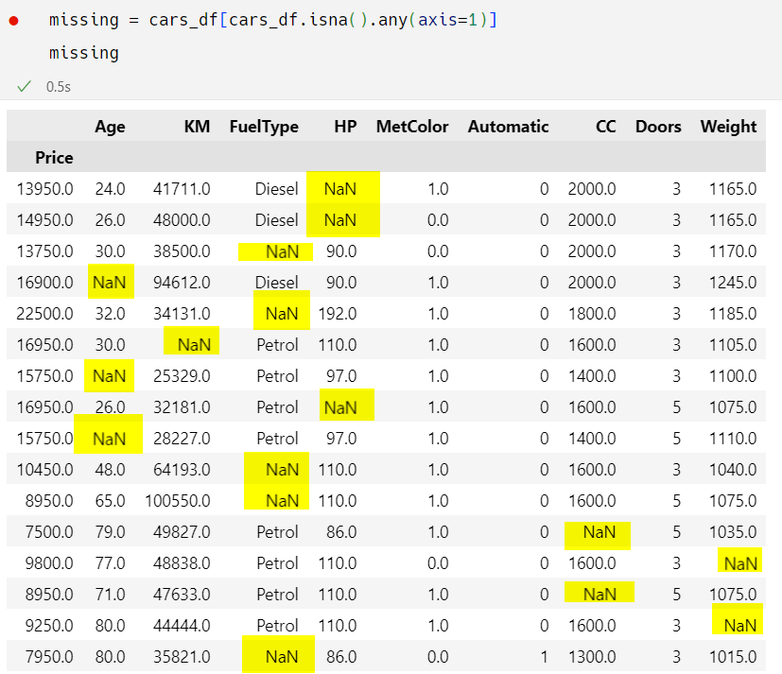
Identifying missing values
Subsetting the rows that have 1 or more missing values

Slide 61
Approaches to fill missing values
Two approaches
Fill the missing values by mean/median, in case of numerical variable
Fille the missing values with the class which has maximum count, in case of categorical variable

Slide 62

Imputing missing values
Look at description to know whether numerical variables should be imputed with mean or median
DataFrame.describe()
Generate descriptive statistics that summarize the central tendency, dispersion and shape of a dataset’s distribution, excluding NaN values

Slide 63
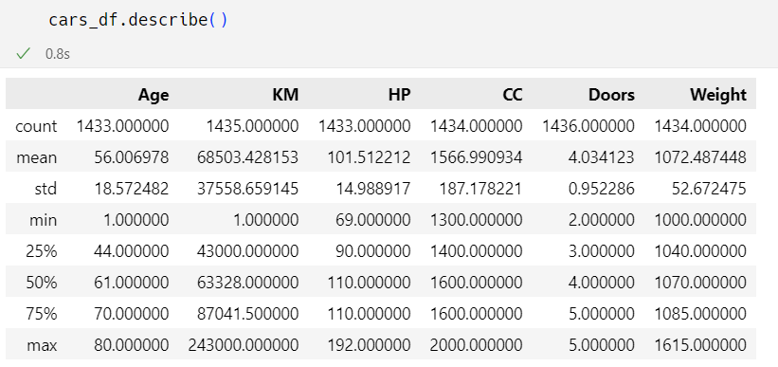
Statistical summary of data

Slide 64
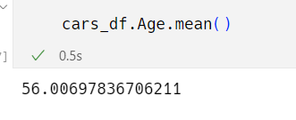

Imputing missing values of “Age”
Calculate the mean value of Age variable
To fill NA/ NaN values using specified value
DataFrame.fillna()

Slide 65
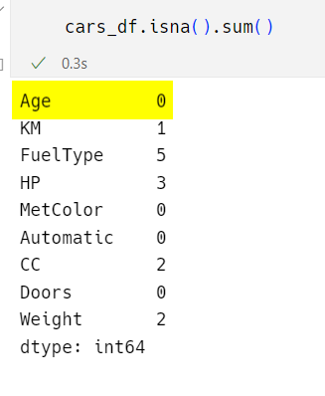
Check dataframe for Age column

Slide 66
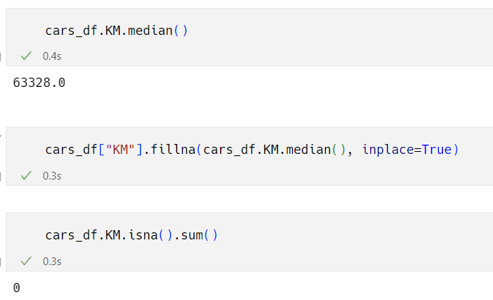
Imputing missing values of “KM”
Calculate the median value of KM variable

Slide 67
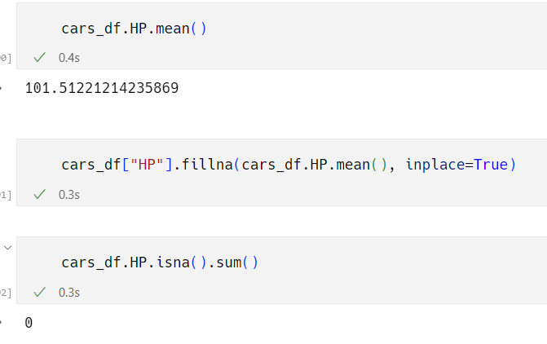
Imputing missing values of “HP”
Calculate the mean value of HP variable

Slide 68
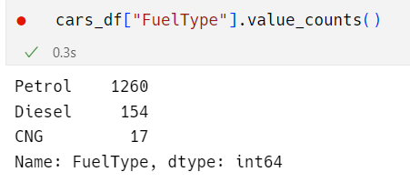
Imputing missing values of “FuelType”
Series.value_counts()
Returns a Series containing counts of unique values
The values will be in descending order so that the first element is the most frequently-occurring element
Excludes NA values by default

Slide 69
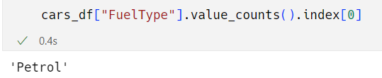
Imputing missing values of “FuelType”
To get mode value of FuelType
To fill Na values using specified value

Slide 70
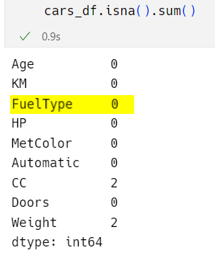
Check dataframe for FuelType column

Slide 71

Imputing missing values of “CC”
To get mode value of CC
To fill Na values using specified value

Slide 72


Imputing missing values of “Weight”
To get mode value of Weight
To fill Na values using specified value

Slide 73

Imputing missing values using lambda functions
To fill Na values using in both numerical and categorical variables at one stretch

Slide 74
Data Visualization

Slide 75

In this part of session
We will learn how to create basic plots using matplotlib library
To install matplotlib library
Plots include Scatter Plot, Histogram, Bar plot

Slide 76
Data Visualization
It allows us to quickly interpret the data and adjust different variables to see their effect
Technology is increasingly making it easier for us to do so
Why visualize data?
Observe the patterns
Identify extreme values that could be anomalies
Easy interpretation

Slide 77
Popular plotting libraries in python
Library | Use case
Matplotlib | To create 2D graphs and plots
Pandas visualization | Easy to use interface, built on matplotlib
Seaborn | Provides a high level interface for drawing attractive and informative statistical graphics
Ggplot | Based on R’s ggplot2, uses Grammar of Graphics
Plotly | Can create interactive plots

Slide 78
Matplotlib
Matplotlib is a 2D plotting library which produces good quality figures
Although it has its origins in emulating the MATLAB graphics commands, it is independent of MATLAB
It makes heavy usage of Numpy and other extension code to provide good performance even for larger arrays.

Slide 79
Scatter Plot
A scatter plot is a set of points that represents the values that obtained for two different variables plotted on a horizontal and vertical axis
When to use Scatter plot ?
They are used to convey relationship between 2 numerical variables.
They are also called as Correlation plots because they show how 2 variables are correlated.

Slide 80

Import matplotlib

Slide 81

Scatter Plot

Slide 82

Scatter Plot

Slide 83
Histogram
It is a graphical representation of data using bars of different heights
Histograms groups numbers into ranges and height of each bar depicts the frequency of each range or bin.
When to use Histogram ?
To represent the frequency distribution of numerical variables

Slide 84

Histogram

Slide 85

Histogram

Slide 86
Histogram

Slide 87
Bar plot
It is a plot that represents categorical data with rectangular bars with lengths proportional to the counts that they represent
When to use Bar plot ?
To represent the frequency distribution of categorical variables
A bar diagram makes it easy to compare sets of data between different groups

Slide 88

Bar plot

Slide 89

Bar plot

Slide 90

Bar plot

Slide 91
Summary
Python provides a vast array of libraries to work on data science, ML and AI.
We looked at one of the core library in Data science i.e Pandas.
Which is widely used for data transformation, data insights.
We also looked at the Matplotlib library to plot the data insights in diagrams

Slide 92
Thank you
Gunesh Shanbhag​
gunesh.shanbhag@sjinnovation.com

